Slide 1




Doctrine - Basic
Introducing ORM Concepts and Doctrine framework, Entities, Repositories
PHP MVC Frameworks
Veselin Malezanov
Technical Trainers
Software University
http://softuni.bg

Slide 2


Table of Contents
ORM Basics - Doctrine
Entity Manager
Entity Repository

Slide 3
Have a question?
#sli.do
#PHP-WEB

Slide 4


ORM Basics - Doctrine
Doctrine DBAL, Doctrine ORM

Slide 5
What Is ORM?
ORM - Object Relational Mapper
Maps PHP objects to database table rows
Database independent
Has its own SQL-like language

Slide 6
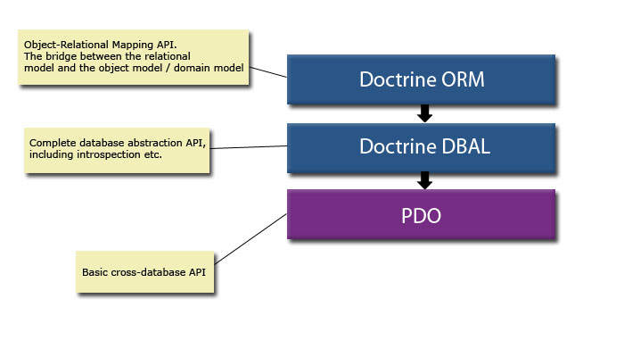
What Is ORM?

Slide 7
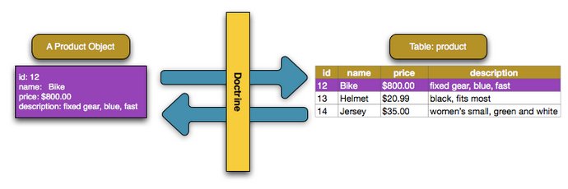
Doctrine ORM
Map database row to PHP object called Entity

Slide 8
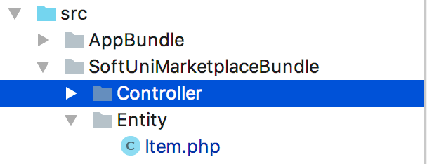
Doctrine ORM
Doctrine entities should live in YourBundle/Entity directory

Slide 9
Doctrine ORM
Doctrine Entity - Basic Mapping with Annotations
@Entity - tells Doctrine the class represents database table
@Column - the property represents database column
@Id - set property as entity primary key
@GeneratedValue - id generation mechanism

Slide 10
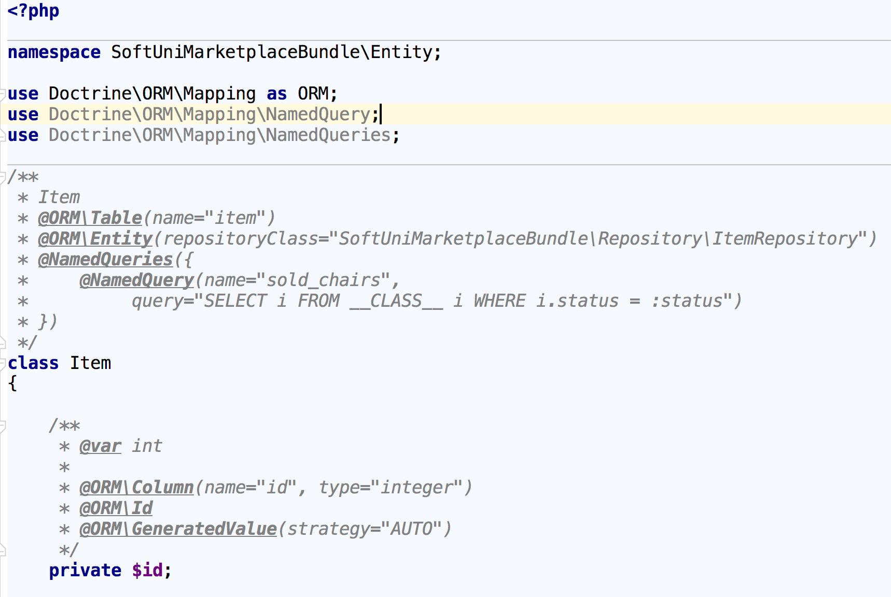
Doctrine ORM
Doctrine Entity

Slide 11
Doctrine ORM
Doctrine Entity
Doctrine entities should only represent database table structure
Do not execute SQL queries from your entities
Do not write heavy logic in your entity classes

Slide 12
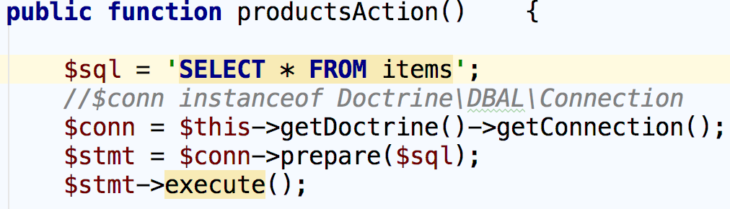
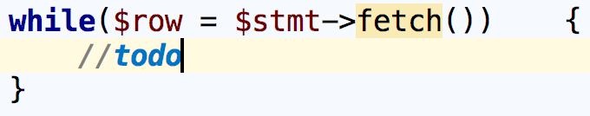
Doctrine DBAL
Data Base Abstraction Layer - built on top of PDO
Examples

Slide 13
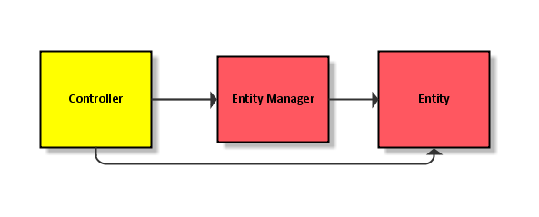
Entity Manager
QueryBuilder, Persisting and Updating Entities

Slide 14
EntityManager
Manage entities - persist(), remove(), flush()
createQuery() - allows us to execute DQL queries
createNamedQuery() - allows us to execute named DQL queries
createQueryBuilder() - allows us to create queries using object-oriented approach

Slide 15
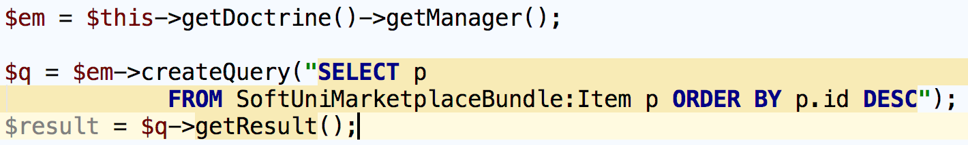
EntityManager
Doctrine Query Language - DQL
Very similar to SQL
With DQL we can update, delete, select entities, but not persist
With DQL we select objects instead of table rows

Slide 16
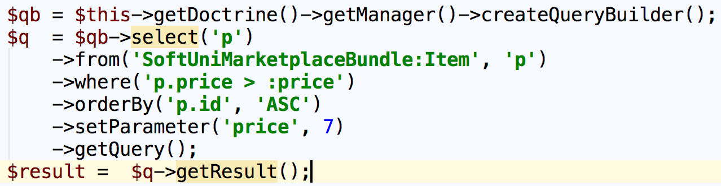
EntityManager
Doctrine Query Builder
Create query in object oriented approach

Slide 17

Entity Repository
Entity Repository, Helper Methods

Slide 18
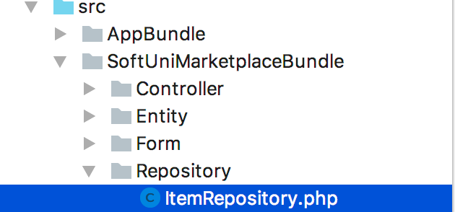
Entity Repository
Makes your code reusable
Isolates your queries from other logic
Provides access to helper methods for each property of your entity
Where the EntityRepository class lives?

Slide 19
Entity Repository Class
How to create?
Automatically created when executing: php bin/console doctrine:generate:entities SomeBundle
Above command will generate Doctrine Entity and empty repository class

Slide 20
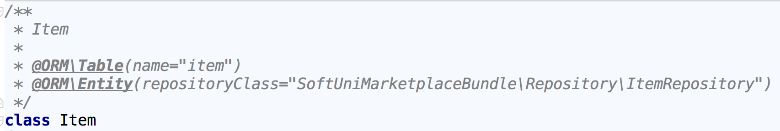
Entity Repository Class
How to create?
Manually
Configure repositoryClass in your entity
In your entity repository class

Slide 21
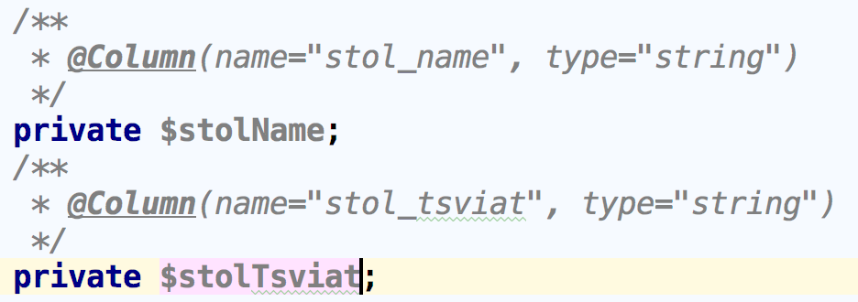

Entity Repository Class
Extending Doctrine\ORM\EntityRepository allows us to access dynamic helper methods for each mapped entity property
Now you have dynamic method names for our entity properties without writing single line of code

Slide 22
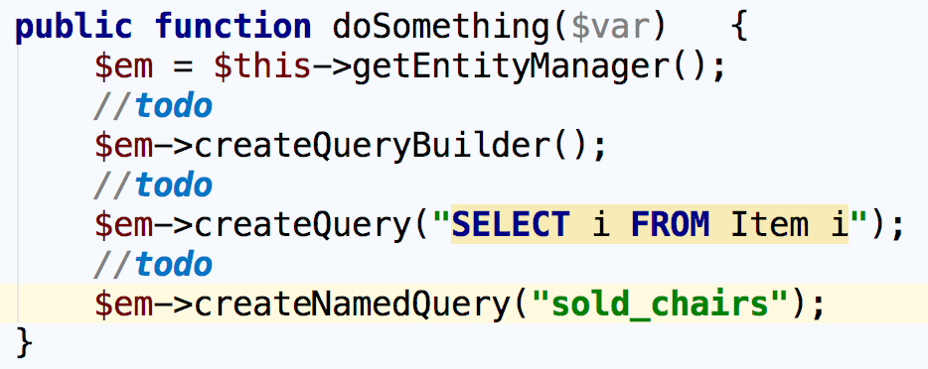
Entity Repository Class
How to access the EntityManager in your repository class

Slide 23
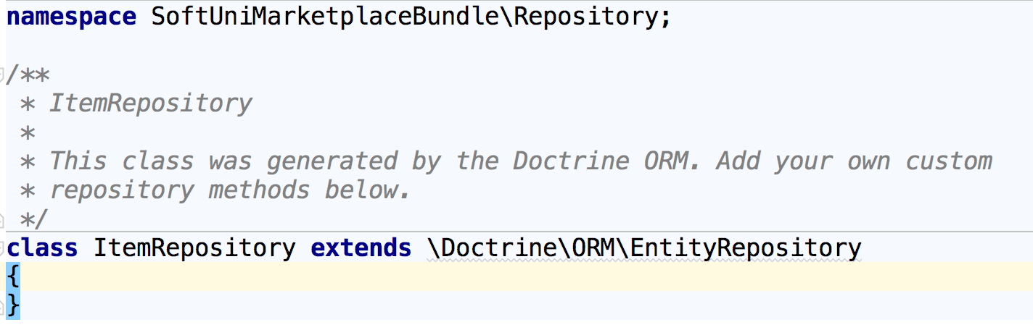
Entity Repository Class
How to create?
Create repository class in src/YourBundle/Repository

Slide 24
Summary
Doctrine ORM - Basic entity mapping, DBAL
Entity Repository - Dynamic helper methods,

Slide 25
REST Controllers and Routing
https://softuni.bg/courses/

Slide 26
License
This course (slides, examples, demos, videos, homework, etc.) is licensed under the "Creative Commons Attribution-NonCommercial-ShareAlike 4.0 International" license

Slide 27



Trainings @ Software University (SoftUni)
Software University – High-Quality Education, Profession and Job for Software Developers
softuni.bg
Software University Foundation
softuni.org
Software University @ Facebook
facebook.com/SoftwareUniversity
Software University Forums
forum.softuni.bg

